Slide 1


Clustering Songs by Attributes (to find additional song value)
*Supervised and Unsupervised Learning Algorithms for Genre Classification

Slide 2
The Project – Subject Matter Expertise
Basic Music Theory
Understanding songs attributes
Investment Funds
Recent emergence of songs as asset class – Hipgnosis Songs Fund and Roundhill Music Fund
Music Copyright
Music Royalties – maximizing value of Songs for investors

Slide 3
Songs as Assets – Investing in Songs
Portfolio Management
Emergence of Song Funds
Genre
Investors understand ‘Genre’
Vintage
Investors understand ‘Vintage’
Songs as Investments
Balanced Song Portfolio
Genre Mix
Genre Subjectivity
Vintage Mix
Vintage Earnings Profile

Slide 4
Business Question & Value Add
Business Question
Can we predict a song's popularity (and therefore value) based on its attributes?
Creating a tool that can classify any given song into a genre or attribute-based cluster is a good first step in this direction. Which leads us to:
Machine Learning Question:
Can we find natural groups of songs with FEATURE PROFILES (by inspecting the song's audio attributes derived by Spotify) onto which we can ascribe VALUE?
Unsupervised learning model – hide genres > find natural clusters

Slide 5
Modeling Expectations
SUPERVISED LEARNING
The models we will pipeline are:
- Logistic Regression (baseline)
- KNN
- SVM (multiclass)
- Random Forests
- Ensemble of best Logreg, KNN and SVM
UNSUPERVISED LEARNING
3 clustering methods:
- K-Means
- DBSCAN
- Hierarchical Clustering
For the supervised learning algorithm we will perform hyperparamter optimisation and model selection to choose a best fit model for multiclass classification.
For the unsupervised learning algorithm we will fit and compare 3 clustering methods.

Slide 6
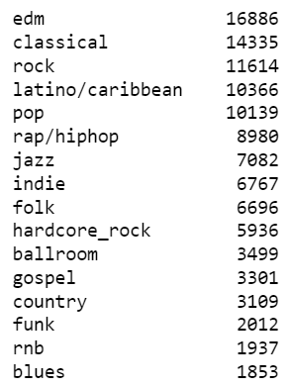
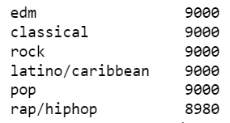

Data Collection and Description
1. 16 genres for unsupervised model, genre tags hidden
2. Reduced to 6 genres and balanced amts for supervised models
SQLITE DATASET of songs in Spotify

Slide 7
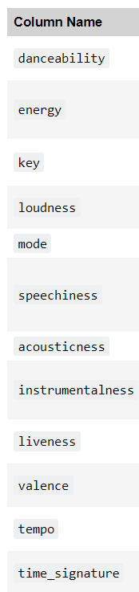
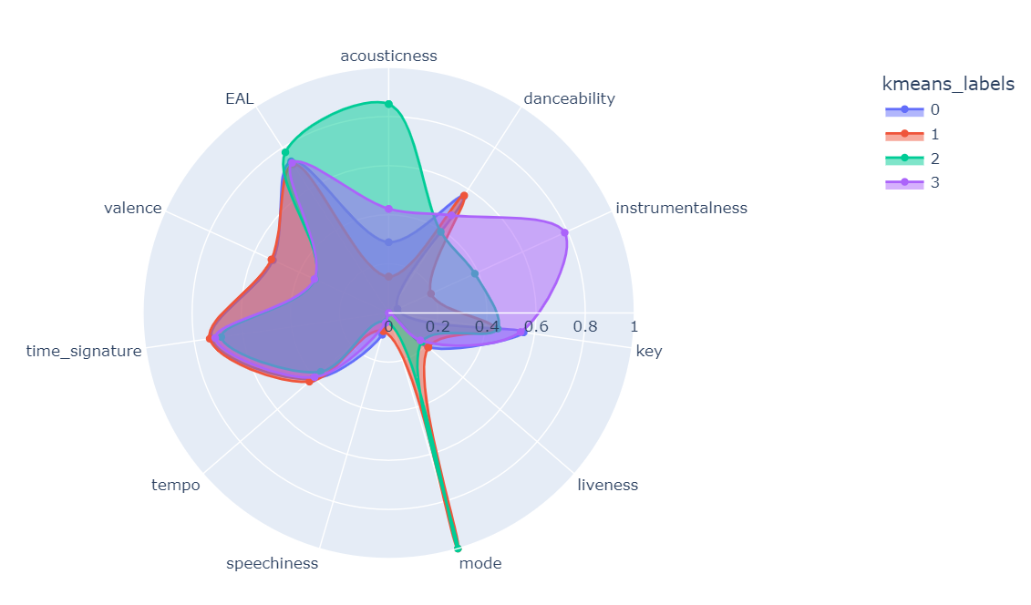
Feature Selection
ENGINEERED FEATURE: EAL (Energy Adjusted Loudness)

Slide 8
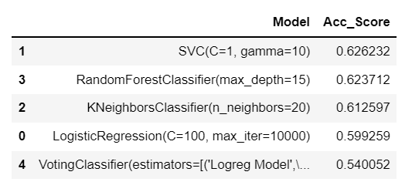
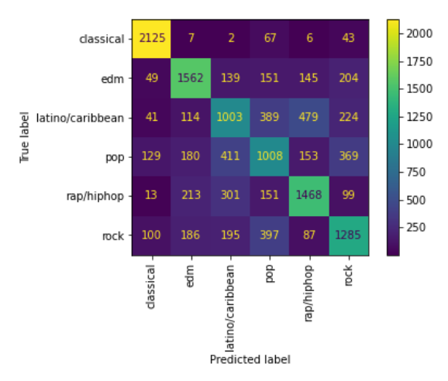
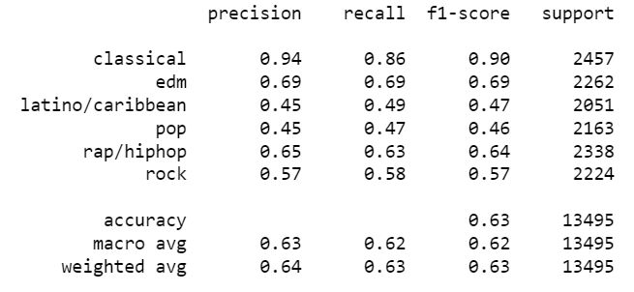

Supervised Modeling Results

Slide 9
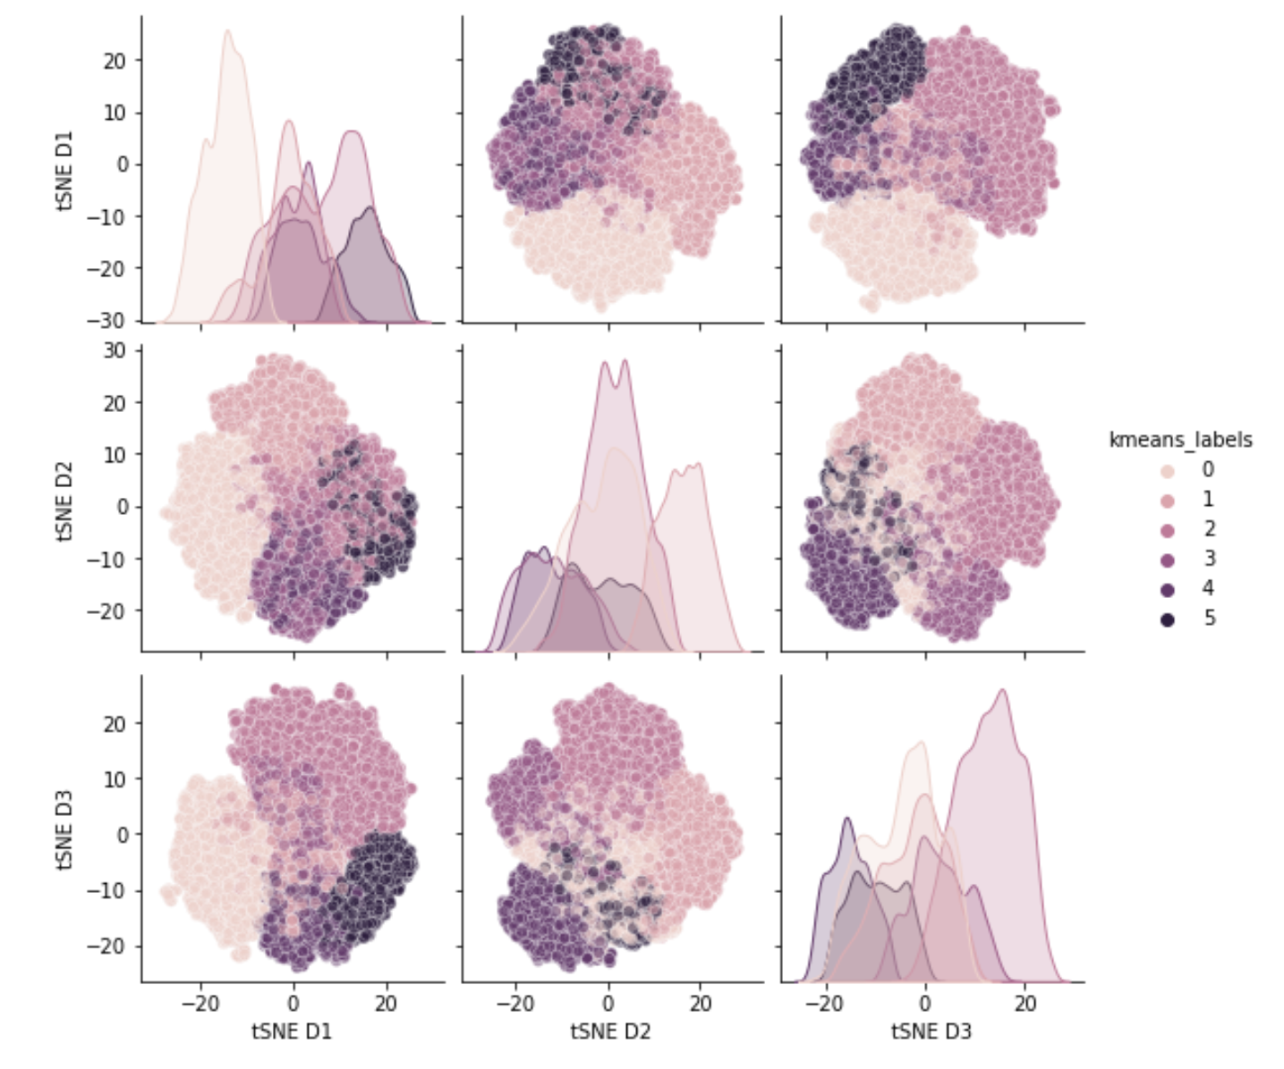
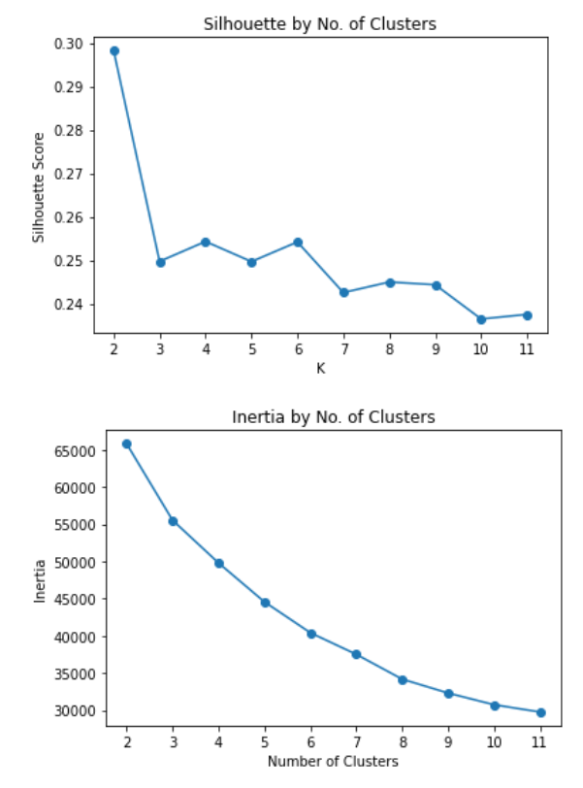
Clustering Result
K-Means: 6 Clusters
Some of the clusters look quite mixed up: the clear separation seems to suggest 4 or maybe 5 clusters.
The model was re-run with 4 clusters.

Slide 10
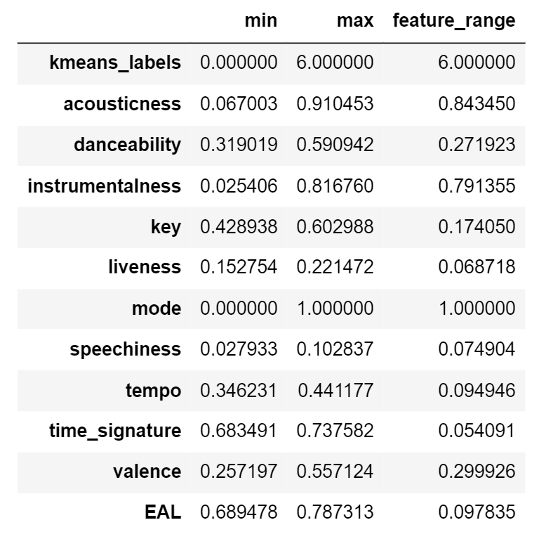
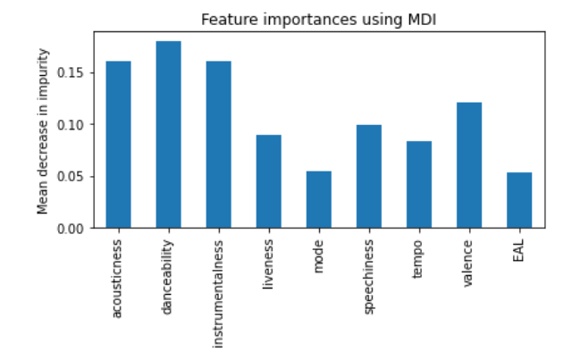















Feature Importance
K-Means
Random Forests
(….also, figure out FacetGrid)

Slide 11
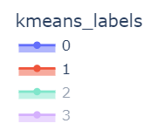
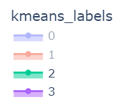
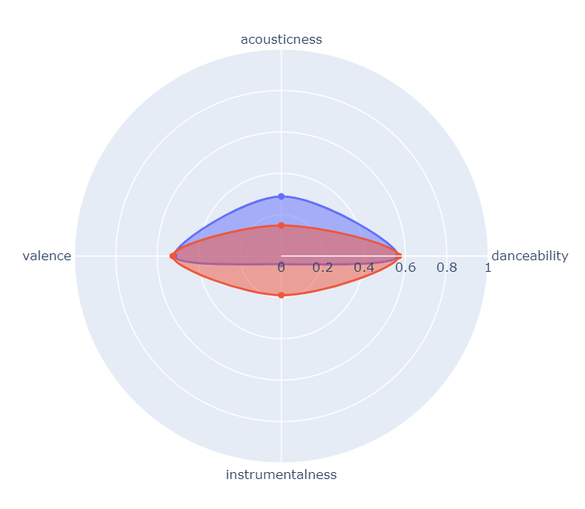
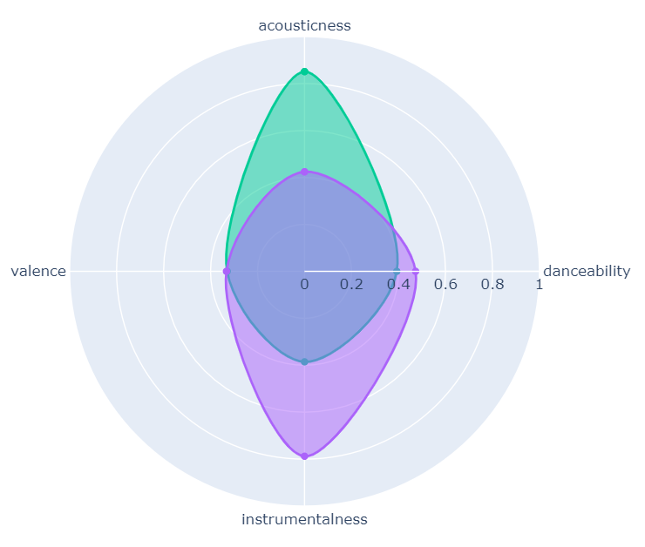
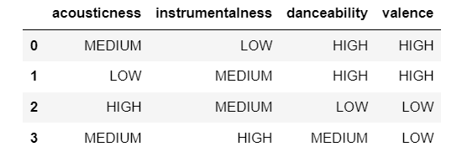
Cluster Interpretations
Cluster 0 rock: http://open.spotify.com/track/0L9k4wQpKCER4MqH33vWJ)
Cluster 1 rock: http://open.spotify.com/track/1yJkF5R6pjUWjaJBTwYySe')
Cluster 0 rap/hiphop: http://open.spotify.com/track/5XzYBtUD8WW5S9LfrL13IQ
Cluster 1 rap/hiphop: http://open.spotify.com/track/4LAS8LPhxEJU4ZCIPmgdZN
Cluster 1 v Cluster 0
Both high danceability and valence (happy songs to dance to)
BUT sound more plugged (Lower acousticness) and higher instrumentalness (less vocal) than Cluster 0
Unsurprisingly, most of the EDM, Dance and Electro tracks fall into this Cluster (then Cluster 3)
0. Contemporary type (more acoustic, less “plugged”
1. Contemporary/Happy and Less Instrumental Dance
2. Classical-type genres, moody less energetic
3. Classical/Moody and More Instrumental Dance
**INDICATIVE of the cluster group

Slide 12

Summary and Findings
Supervised learning found it difficult to predict human genre tags
Something cultural defines these contemporary genres outside of song features
Features that capture this cultural aspect could be used to enhance this modelling,
typical demographic audience
geographical location
average age
social media metrics
synch information (games, films, tv shows the songs are used in)
vintage, etc
The unsupervised learning algorithms performed better at categorising the songs
We found 4 distinct clusters
We were able to define the clusters in a way that is understandable to the average human music listener and cross reference the clusters against 'human' genre classes

